Slide 1
Investigation of large grain cavity surfaces
M. Ge¹, G. Wu¹, P. Kneisel², K. Zhao³
^{1.} Fermilab ^{2.} Jefferson Lab ^{3.} Peking University
Replicas of cavity RF surface of a large grain 1-cell cavity were made. The cavity topology and surface roughness were compared to other 1-cell cavities. Field enhancement of grain boundaries will be analyzed and discussed.

Slide 2
Outlines
Fermilab surface replica technique
Large grain cavity surface optical inspection
Cavity replica results
Large grain cavity surface compared to other cavities
Summary

Slide 3
Fermilab Cavity diagnostics – Surface replica
Capable to reveal the 3-D profile of geometric defects and to establish the mechanism of local quench at the defects based on magnetic field enhancement.
Useful to assess surface preparation effectiveness by extracting surface roughness
Achieved resolution in micron detail ( to resolve features~ <100µm in diameter; <10µm in depth).
M Ge, G Wu, D Burk, J Ozelis, E Harms, D Sergatskov, D Hicks, and L D Cooley,
Routine characterization of 3-D profiles of SRF cavity defects using replica techniques,
Manuscript to be submitted to Journal of Superconducting Science and Technology.

Slide 4
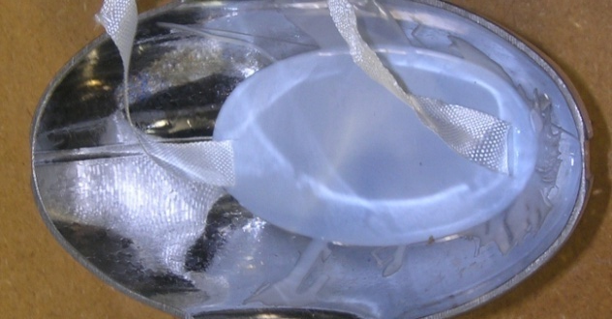
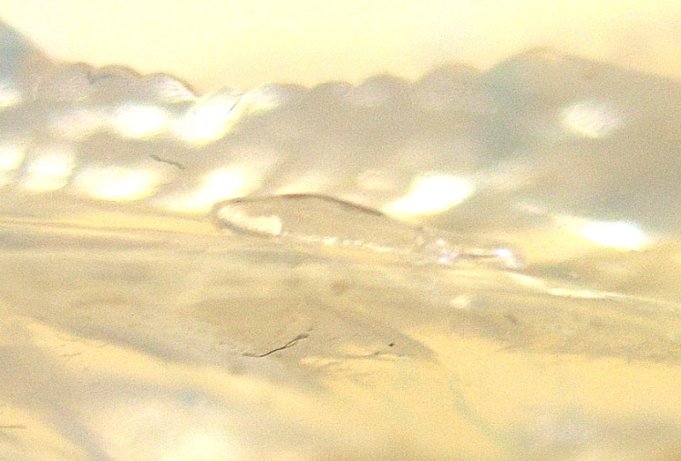
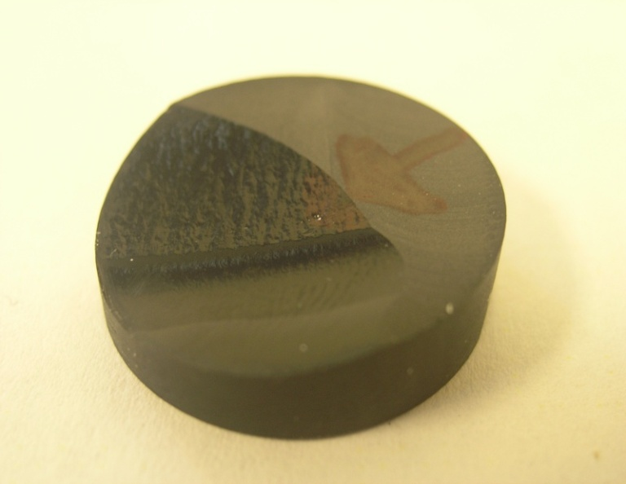
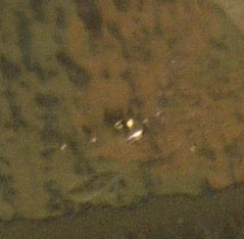
Surface replica – extraction and surface scan
String
Silicone
Feature on silicone
Silicone pouring into an open half cell with a string embedded
Visually indentify the features
Epoxy casting on silicone
Feature’s 3D shape by profilometer scanning

Slide 5
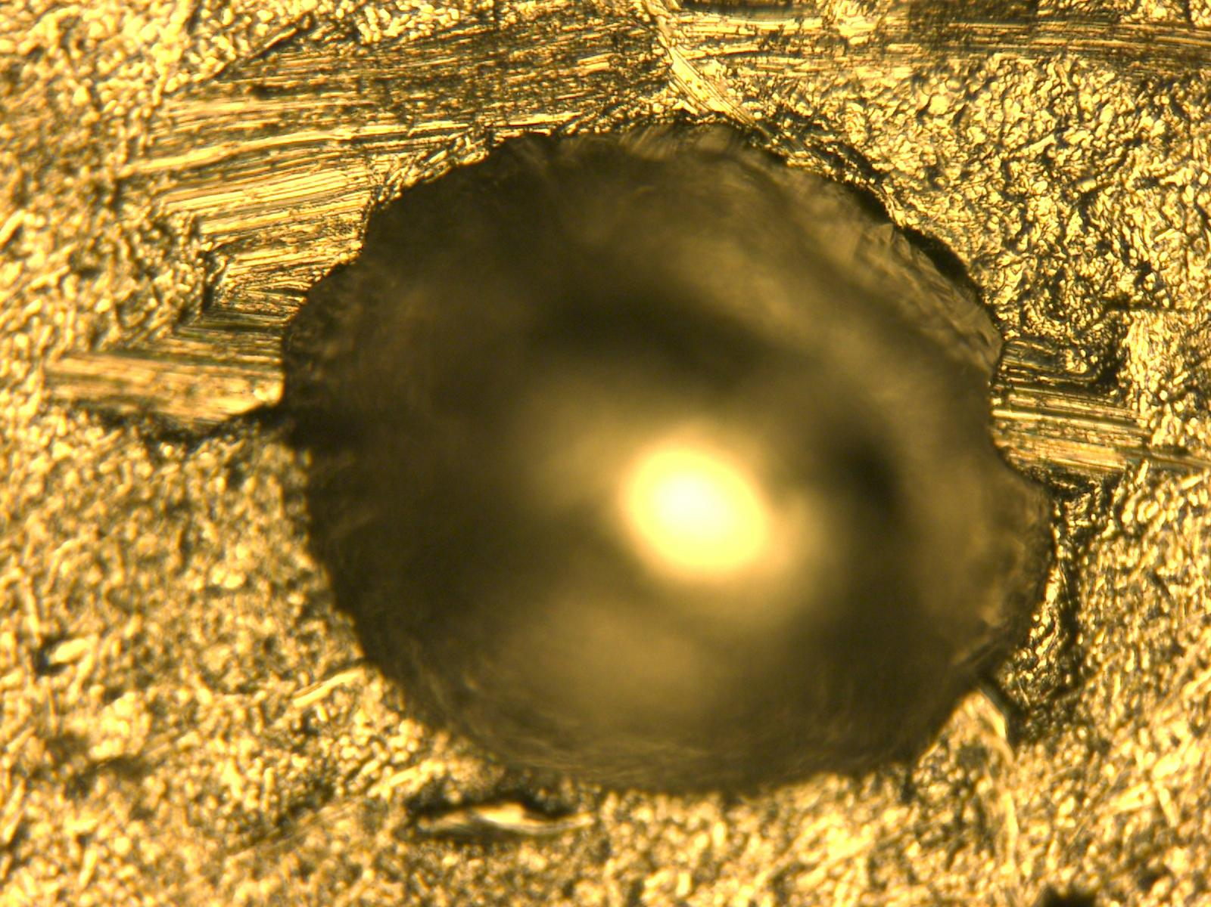
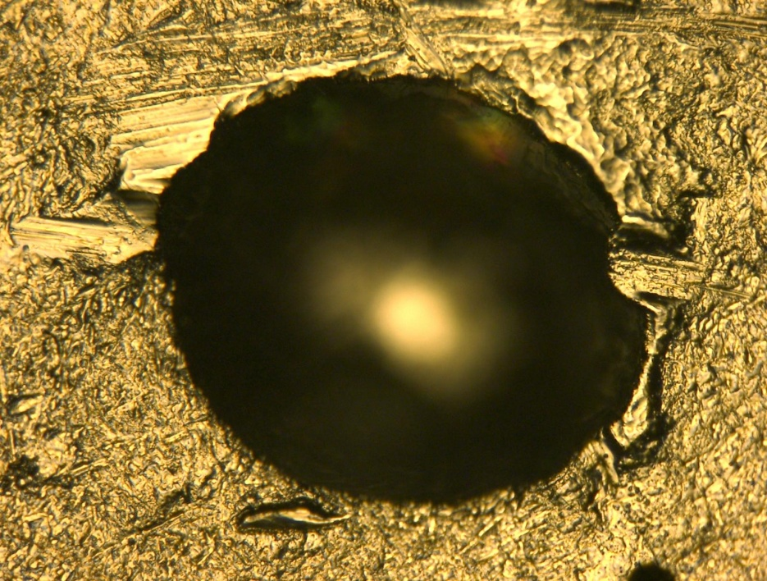
Surface replica - resolution
A man-made pit 125µm deep, 300µm in diameter
Pit replica
profile of a pit on the Nb coupon
profile of pit’s replica
Overall, 1 µm detail can be replicated

Slide 6
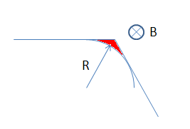
A discussion about surface detail
As magnetic field at the edge of the defect approaches the thermal critical magnetic field, the magnetic flux then enters the corner area deeper, depending on the field enhancement factor.
At this time, the defect can be divided into one lossy corner and a remaining flux-free body.
The effective corner curvature is in micron scale as in the case of normal conducting niobium.
High resolution profilometer (KLA Tencor Model P-16)
Probe tip with 0.8 µm diameter
Horizontal resolution < 1 µm
Vertical resolution ~1 Å
Surface replica resolution sufficient to characterize the RF surfaces
J. Knobloc, et al., “High Field Q Slope in Superconducting Cavities Due to Magnetic Field Enhancement at Grain Boundaries,” in Proc. of 9th Workshop on RF Superconductivity, Santa Fe, New Mexico,1999, pp. 77-91

Slide 7
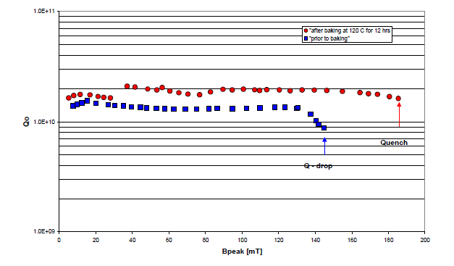
1-cell cavity: PKU-LG1
43 MV/m. 185 mT
NingXia large grain RRR niobium
Post purified
BCP processed
Low temperature baking
Features found at multiple locations:
BCP stains
BCP etching pits
Weld Pits
Steep grain boundaries
P. Kneisel, “Progress on Large Grain and Single Grain Niobium – Ingots and Sheet and Review of Progress on Large Grain and Single Grain Niobium,” in Proc. of 13th Workshop on RF Superconductivity, Beijing, China, 2007.

Slide 8
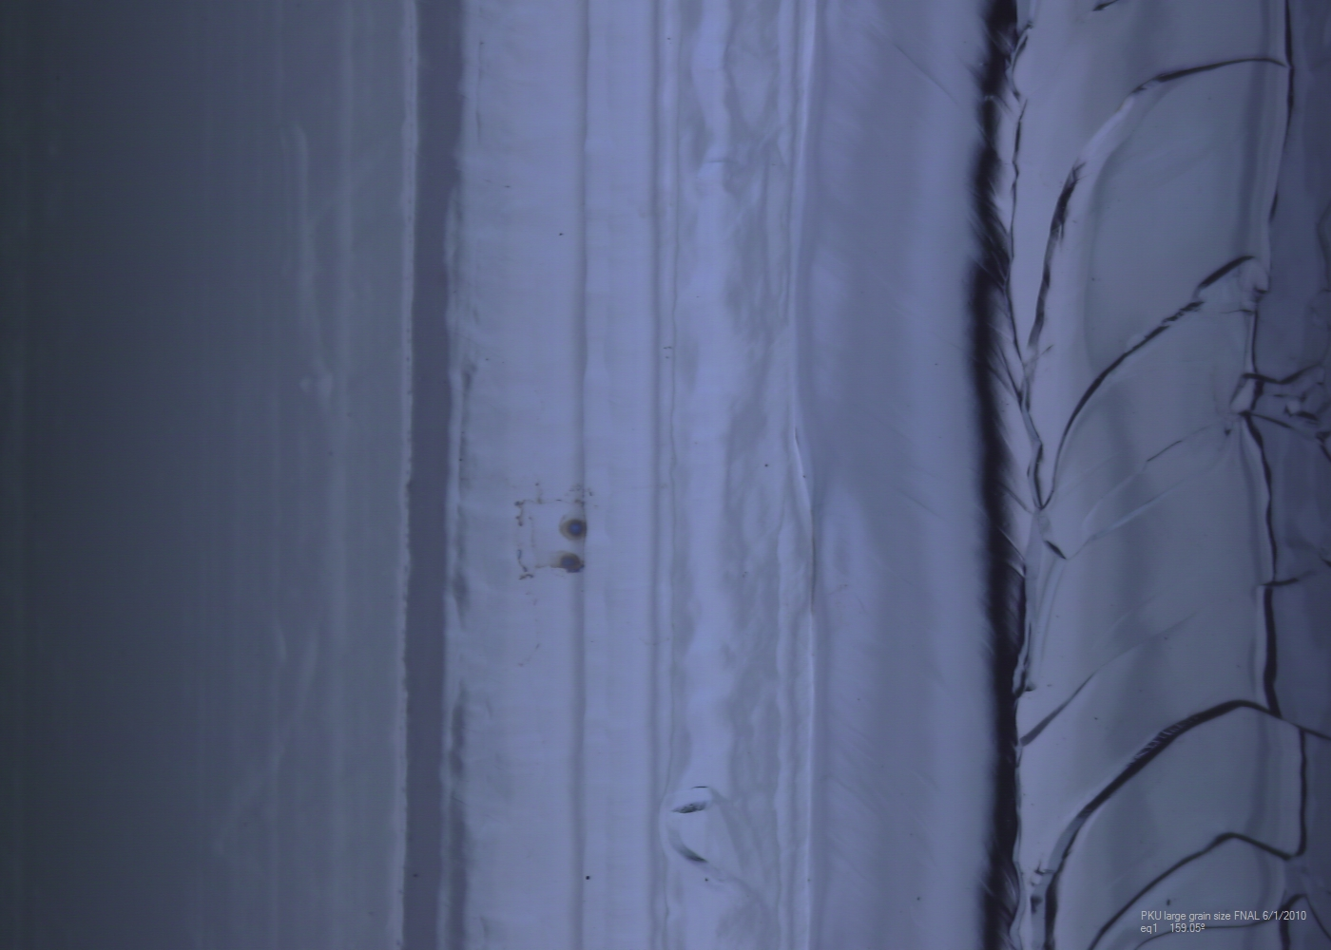
Optical features of PKU-LG1
BCP acid stains
This picture covers 10mm in length

Slide 9
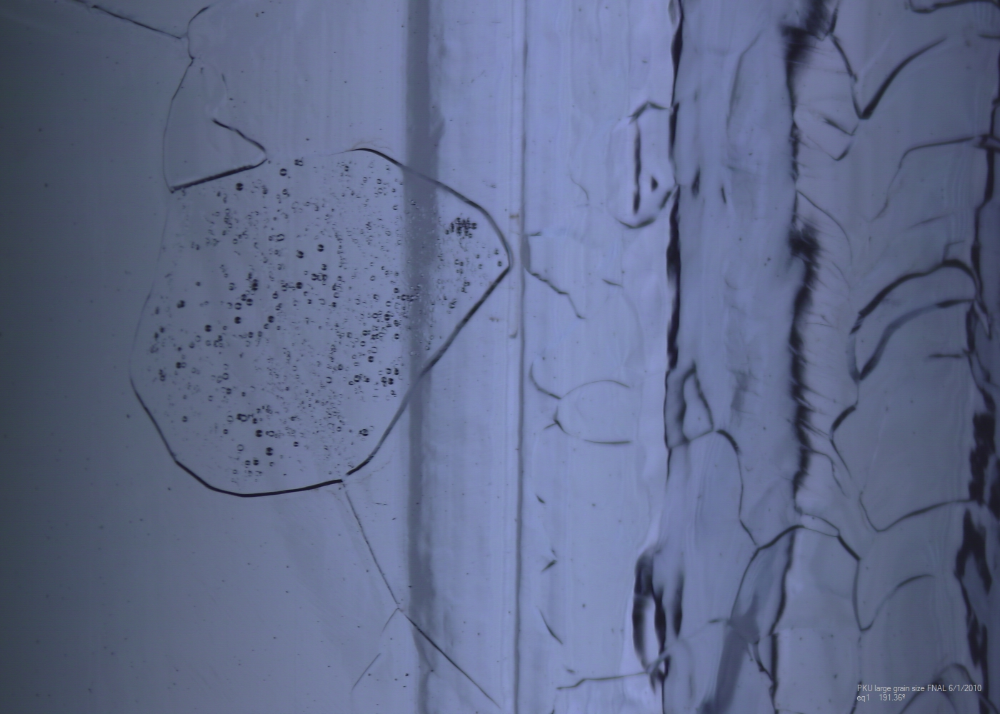
Optical features of PKU-LG1
BCP etching pits

Slide 10
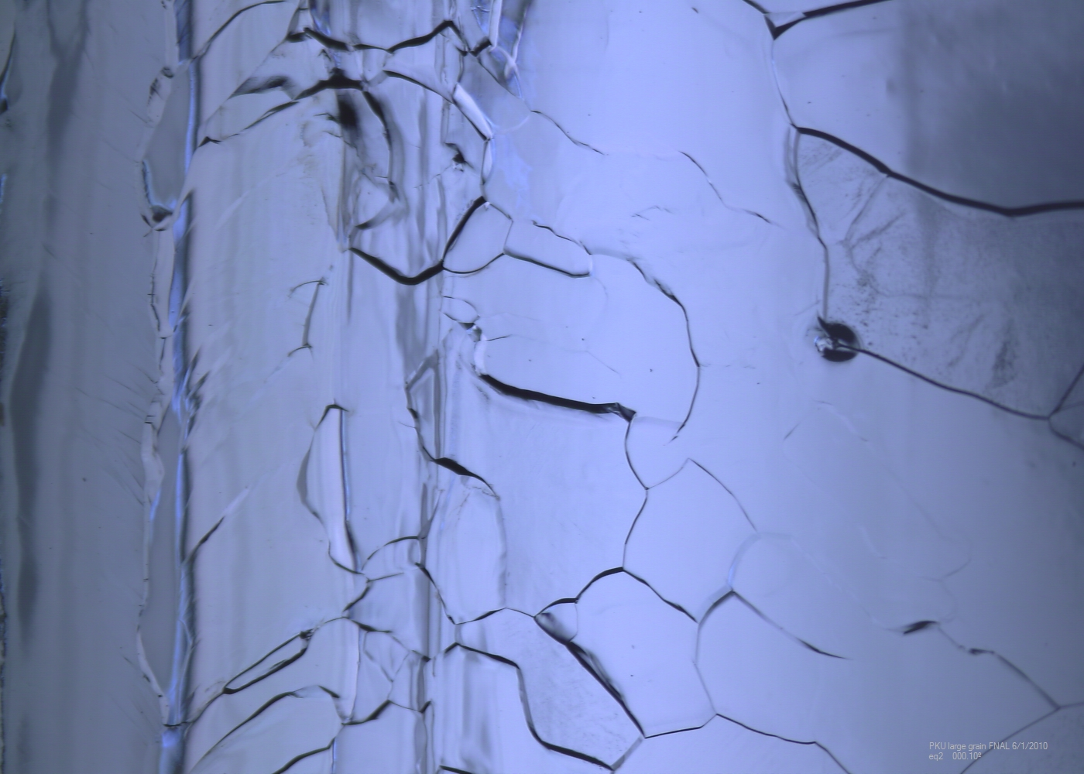
Optical features of PKU-LG1
Pits in weld and HAZ

Slide 11
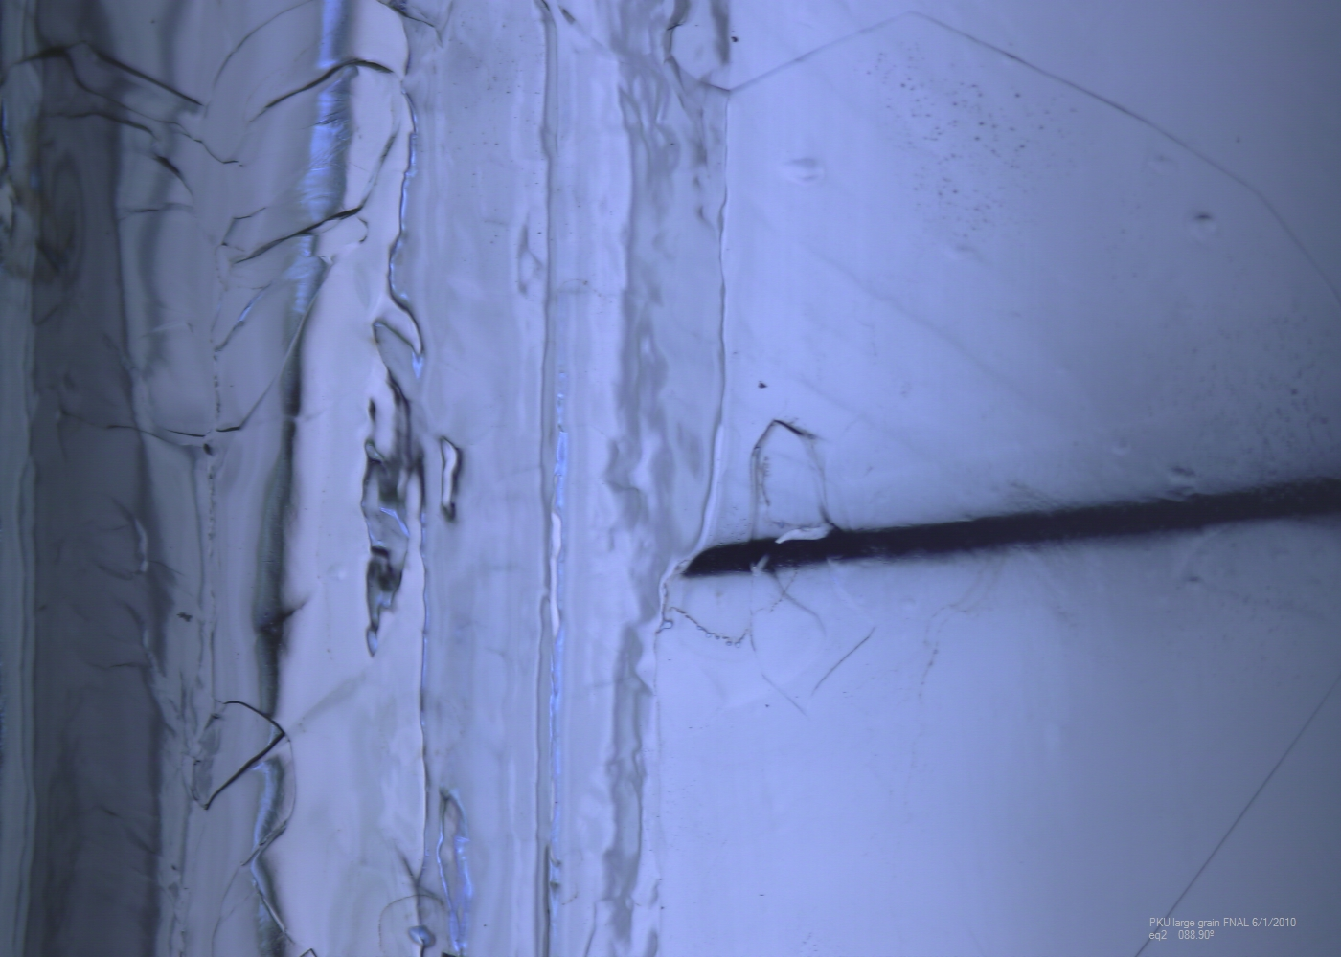
Optical features of PKU-LG1
BCP enhanced grain boundary

Slide 12
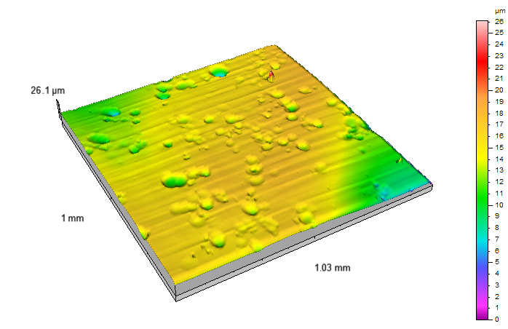
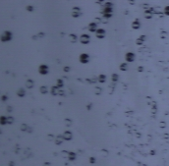
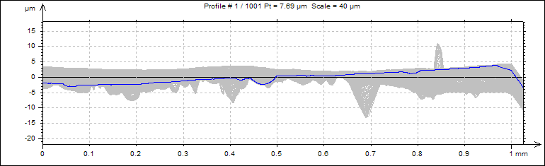
The measurement of intra grain etching pits
Optical image of PKU-LG1
A result from surface scanning profilometer
Cross section view
BCP etching pits, while interesting, do not affect cavity performance
Notes:
Add results

Slide 13
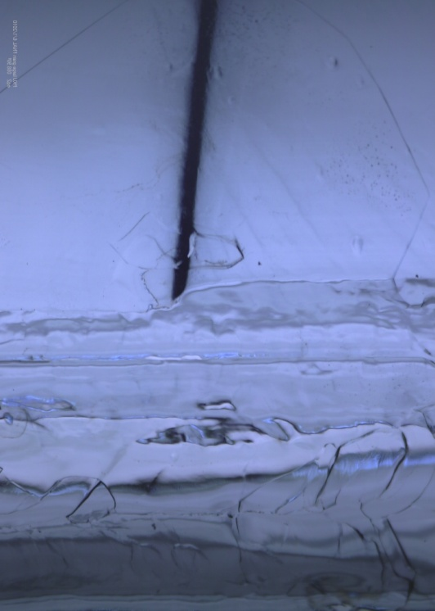
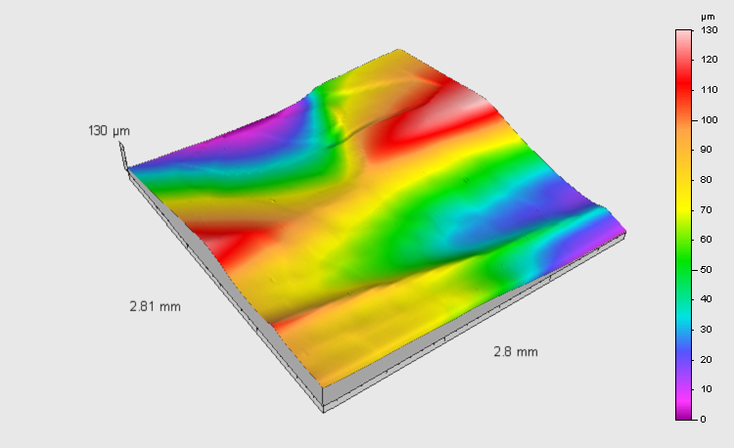
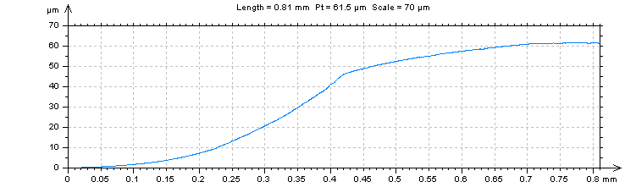
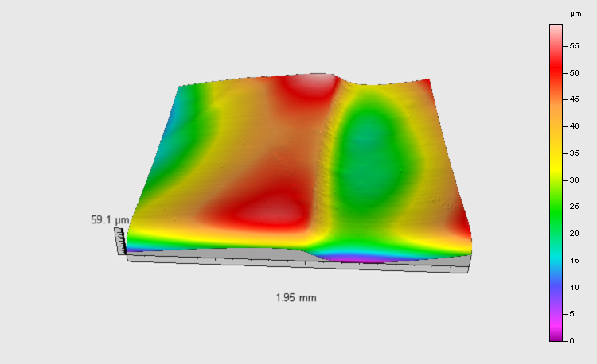
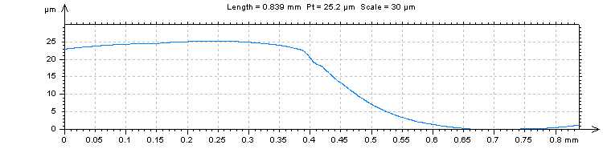
The measurement of grain boundary step
A-A’
B-B’
Joint of grain boundary
A-A’
Joint of grain boundary
Profile on A-A’
Welding seam
B-B’
Optical image of PKU-LG1
The height of step on A-A’: 60µm
The height of step on B-B’: 25µm
A result from surface scanning profilometer
Profile on B-B’
Notes:
Add results

Slide 14
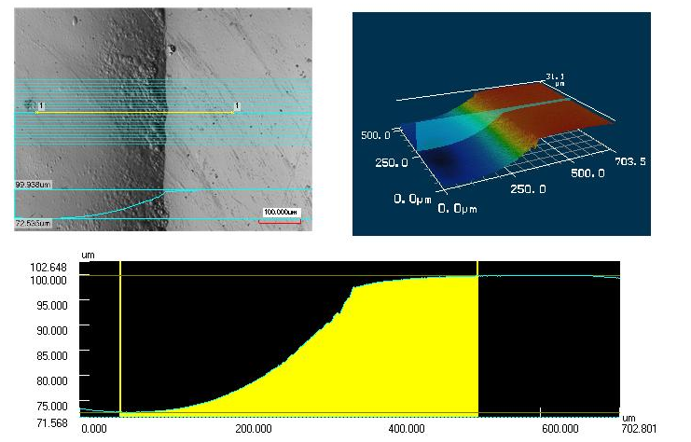
The measurement of grain boundary step
A result from confocal laser scanning microscope for previous B-B location.
Long and steep grain boundaries do not affect cavity performance

Slide 15
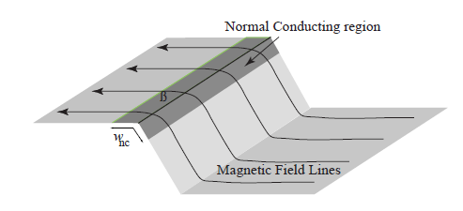
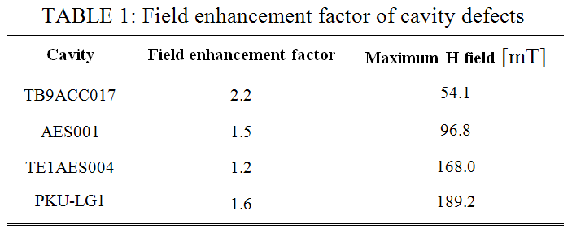
Field enhancement factor with step model
Magnetic field enhancement model
185
Magnetic field enhancement model suggested the features in this cavity cannot fully explain the cavity performance limitations.
Geometric topology serves only a secondary role in limiting cavity performances. (based on grain boundary and other benign pits.)

Slide 16
Cavity surface features comparison
How large grain BCP processed RF surfaces differ from other cavities?
Cavities have apparent geometric defects
  Bumps
  Pits
  Scratches
  Grain boundaries (Large grain)
Cavities have no visible defects
  Surface roughness in
  Weld seam
  Heat Affected Zone (HAZ)
  Normal area.
Cavities represent six categories
  Fine grain BCP
  Large grain BCP
  Single crystal BCP
  Fine grain light EP
  Fine grain heavy EP
  Fine grain Tumble polishing plus light EP

Slide 17
Cavity surface roughness database
Welding seam
HAZ
Normal area
Brand new
TE1PAV001
(3 similar cavities)
Brand new
TE1ACC006
(2 similar)
PKU single crystal BCP‘d cavity
BCP'd 70µm
NR-6
(3 similar)
EP'd 40µm
TE1ACC005

Slide 18
Cavity surface roughness database
Welding seam
HAZ
Normal area
EP'd 120µm
TE1ACC003
(8 similar)
EP'd 150µm
TB9ACC017
Tumbling
100-120µm
TE1ACC004
(4 similar)
PKU Large grain BCP‘d cavity
While roughness is similar in weld seam, it is different in HAZ and normal area.

Slide 19
Surface roughness vs. Gradient
TESLA shape ,quenched but no obvious defects
Similar trend for Ra
Cavity performance becomes less dependent on the surface roughness as the maximum magnetic field reached a plateau; Large grain+BCP performs well as EP+fine grain

Slide 20
Conclusions
Large steep grain boundaries in a large grain cavity are found; performance cannot be explained by magnetic field enhancement.
Surface roughness inside grains by BCP is comparable to modern electropolished cavities.
When cavity does not perform, don’t blame on large grain geometric features. Find the real causes!
Large grain BCP works (needs more data for repeatability)
More cavity surface studies can be found here:
G. Wu, M. Ge, P. Kneisel, K. Zhao, L. Cooley, J. Ozelis, D. Sergatskov and C. Cooper, “Investigations of Surface Quality and SRF Cavity Performance”, manuscript submitted to IEEE transactions on Applied Superconductivity.

Slide 21
Extra slides

Slide 22
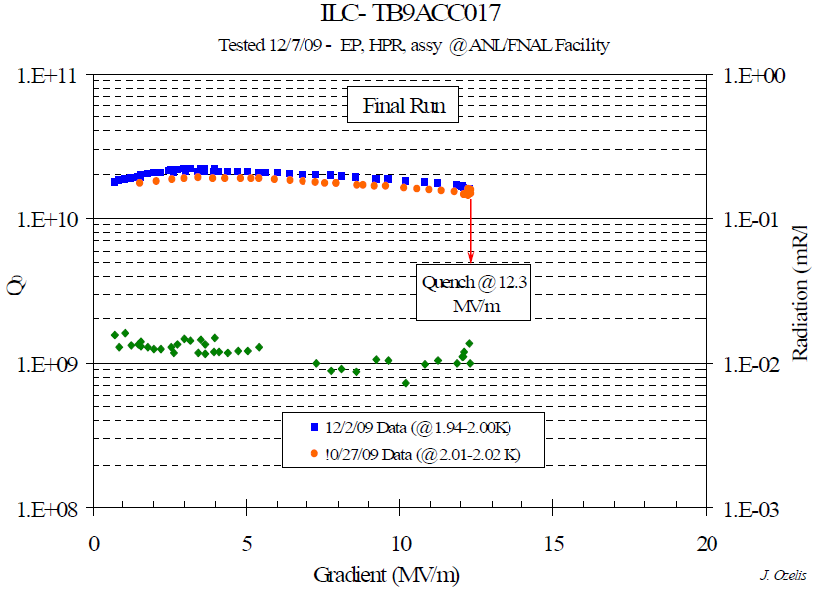
Surface defect limits cavity performance at low field
1.3GHz 9-cell cavity TB9ACC017
Y-Y’
X-X’
EB-Welding seam
X-X’
TB9ACC017 quenched at 12.3MV/m,
Pit was found at Cell #4 equator 180 deg region (quench location),
the pit is 150 µm deep and 200 µm wide on the top.
Y-Y’

Slide 23
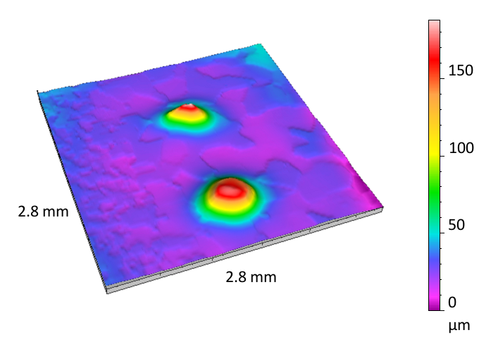
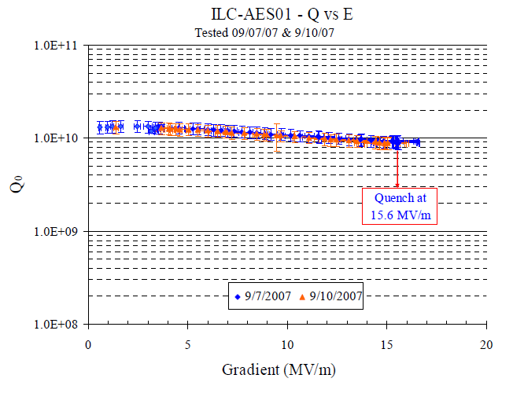
Surface defect limits cavity performance at low field
Spot (a)
Spot (b)
Spot A height 160µm, diameter 700µm on bottom
AES001 quenched at 15.6~21MV/m,
Twin peaks were found at Cell #3 equator 169 deg region
Spot B height 155µm, diameter 1000µm on bottom
Notes:
22MV/m curve?

Slide 24
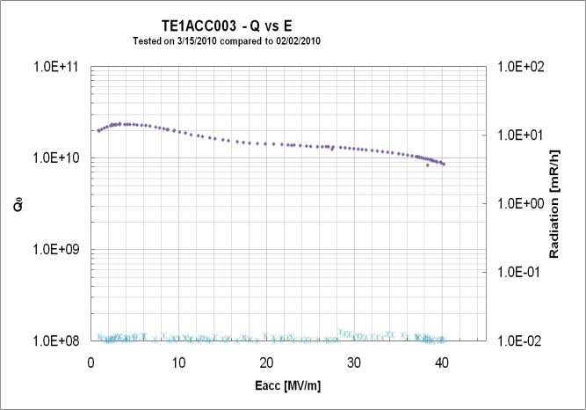
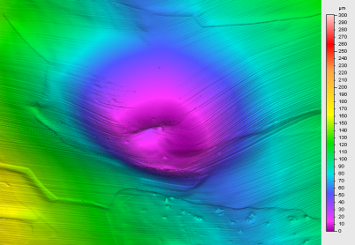
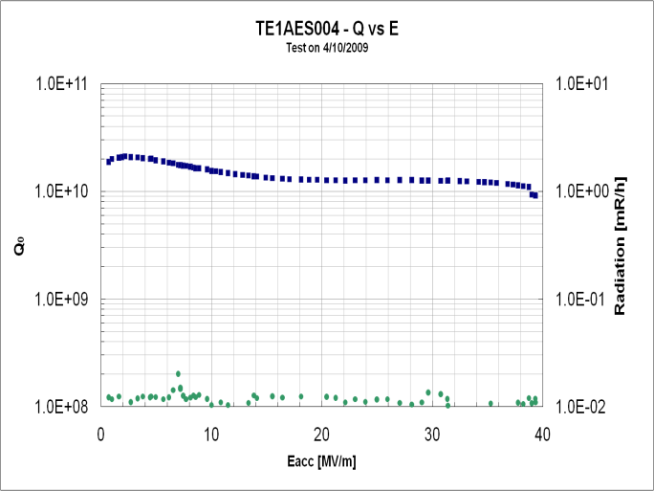
Surface defect limits cavity performance at high field
Equator
welding seam
HAZ
40.2 MV/m quenched at pit region
TE1ACC003
Diameter: 400µm,Depth: 60µm
Equator welding seam
TE1AES004
Diameter: 1300µm, Depth: 70µm
A 15µm high tiny bump in the center.
39MV/m quenched NOT at pit region

Slide 25
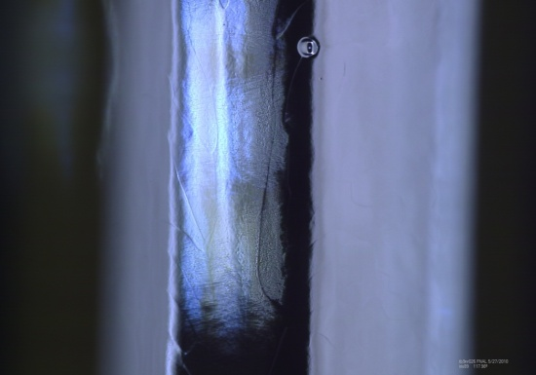
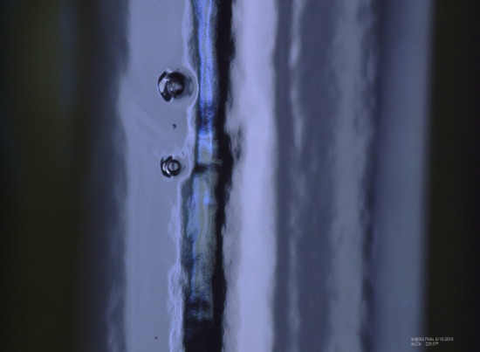
Reveal pits profile on iris region
Diameter: 400µm,Depth: 70µm
TB9RI026
Spot A
Spot A
Spot B
TB9jl002
Spot A: Diameter: 800µm,Depth: 180µm
Spot B
Spot B: Diameter: 550µm,Depth: 110µm
A 20µm deep crevice in center

Slide 26



Roughness comparison
Large grain BCP’d cavity
Eacc reached 43MV/m!
Fine grain EP’d cavity
Eacc reached 40MV/m!
Fine grain BCP’d cavity
Eacc reached 26MV/m!
 | Large grain BCP’d cavity | Fine grain EP’d cavity | Fine grain BCP’d cavity
Ra (µm) | 0.0516 | 0.053 | 0.257
Rz (µm) | 0.283 | 0.275 | 1.21
Rq (µm) | 0.0648 | 0.0665 | 0.333

Slide 27
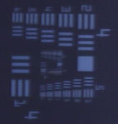
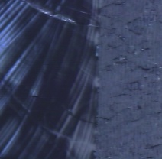
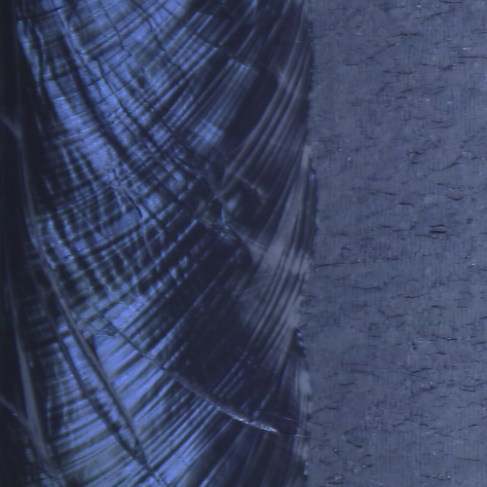
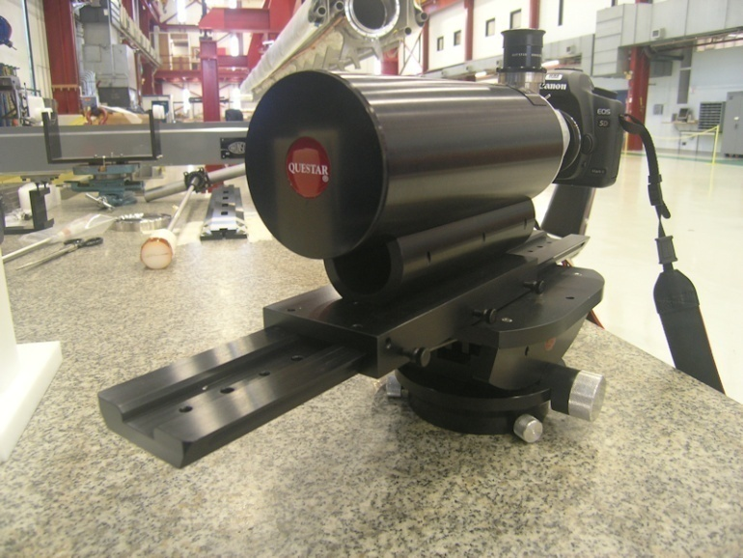
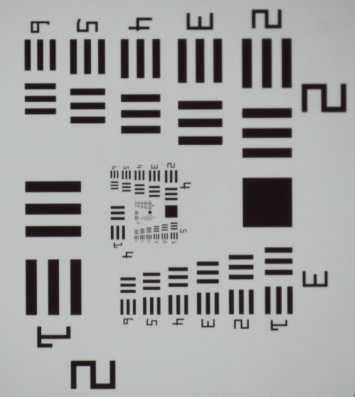
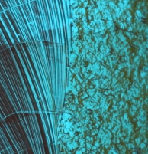
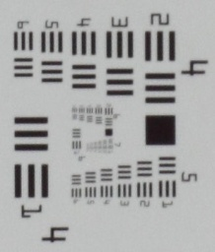
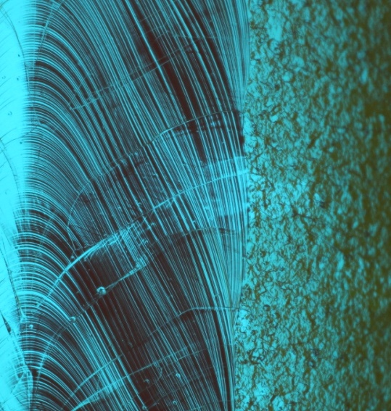
Fermilab Cavity diagnostics – optical inspection
 | Resolution (µm)
Questar | ~5
Kyoto/KEK | ~25
Kyoto/KEK: standard ILC cavities. Questar: All style cavities
Camera inspection system by Kyoto University/KEK
Image of TE1ACC006
Questar QM-1, first adopted at Cornell USAF-1951 seen by Questar
Image of 3C9FER001

